Slide 1
// Dynamic Method Dispatch
class A {
void callme() {
System.out.println("Inside A's callme method");
}
}
class B extends A {
// override callme()
void callme() {
System.out.println("Inside B's callme method");
}
}
class C extends A {
// override callme()
void callme() {
System.out.println("Inside C's callme method");
}
}
class Dispatch {
public static void main(String args[]) {
A a = new A(); // object of type A
B b = new B(); // object of type B
C c = new C(); // object of type C
A r;
r = a;
r.callme();
r = b;
r.callme();
r = c;
r.callme();
}
}
The output from the program is shown here:
Inside A's callme method
Inside B's callme method
Inside C's callme method

Slide 2
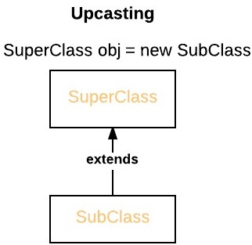
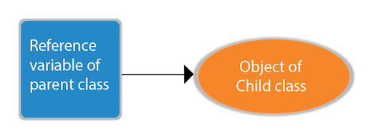
If the reference variable of Parent class refers to the object of Child class, it is known as upcasting

Slide 3
class Bike{
void run(){System.out.println("running");}
}
class Splendor extends Bike{
void run(){System.out.println("running safely with 60km");}
public static void main(String args[]){
Bike b = new Splendor();//upcasting
b.run();
}
}

Slide 4
class Bank{
float getRateOfInterest(){return 0;}
}
class SBI extends Bank{
float getRateOfInterest(){return 8.4f;}
}
class ICICI extends Bank{
float getRateOfInterest(){return 7.3f;}
}
class AXIS extends Bank{
float getRateOfInterest(){return 9.7f;}
}
class TestPolymorphism{
public static void main(String args[]){
Bank b;
b=new SBI();
System.out.println("SBI Rate of Interest: "+b.getRateOfInterest());
b=new ICICI();
System.out.println("ICICI Rate of Interest: "+b.getRateOfInterest());
b=new AXIS();
System.out.println("AXIS Rate of Interest: "+b.getRateOfInterest());
}
}

Slide 5
Output:
SBI Rate of Interest: 8.4
ICICI Rate of Interest: 7.3
AXIS Rate of Interest: 9.7

Slide 6
Abstract class
A class that is declared with abstract keyword is known as abstract class in java. It can have abstract and non-abstract methods (method with body)
abstract keyword in front of the class keyword
Restricted class that cannot be used to create objects
Cannot declare abstract constructors, or abstract static methods
abstract class Sample
{
// contents
}

Slide 7
abstract class A {
abstract void callme();
void callmetoo() {
System.out.println("This is a concrete method.");
}
}
class B extends A {
void callme() {
System.out.println("B's implementation of callme.");
}
}
class AbstractDemo {
public static void main(String args[]) {
B b = new B();
b.callme();
b.callmetoo();
}
}

Slide 8
abstract class Figure {
double dim1;
double dim2;
Figure(double a, double b) {
dim1 = a;
dim2 = b; }
abstract double area();
}
class Rectangle extends Figure {
Rectangle(double a, double b) {
super(a, b);
}
double area() {
System.out.println("Inside Area for Rectangle.");
return dim1 * dim2; }
}
class Triangle extends Figure {
Triangle(double a, double b) {
super(a, b);
}
double area() {
System.out.println("Inside Area for Triangle.");
return dim1 * dim2 / 2;}}
class Main {
public static void main(String args[]) {
Rectangle r = new Rectangle(9, 5);
Triangle t = new Triangle(10, 8);
Figure figref; // no object is created
figref = r;
System.out.println("Area is " + figref.area());
figref = t;
System.out.println("Area is " + figref.area());
}
}
Reference variable → Can be used to refer to an object of any class derived from super class

Slide 9
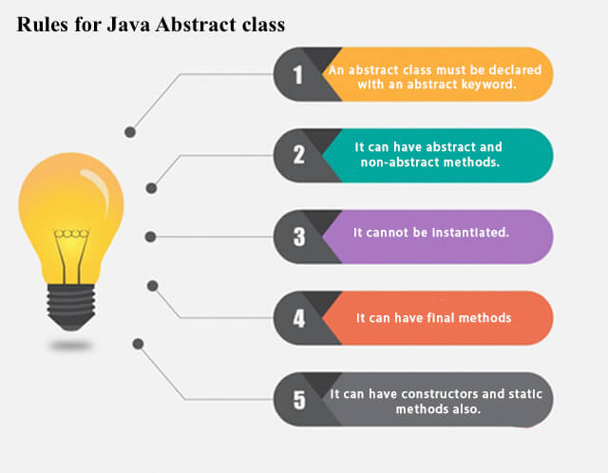
Abstract Classes

Slide 10
Final keyword
Final Variables- can not be changed
final int a=10;
Final Methods – can not be overridden
final void show();
Final Class- Prevent a class from inheritance
can not be inherited
final class classname
{
}

Slide 11
Interfaces
An interface is a way to describe what classes should do, without specifying how they should do it.
Interfaces are similar to abstract classes
Interfaces can contain only abstract methods and constants.
Interfaces cannot be instantiated.
Can use interface as a data type for variables.
Can also use an interface as the result of a cast operation.

Slide 12
Declaration- syntax
An interface is created with the following syntax:
Access modifier interface interfaceID
{
//constants/method signatures
}
Extending interfaces
modifier interface interface_name extends base _interface
{
}

Slide 13
Interface member – constants
An interface can define named constants, which are public, static and final (these modifiers are omitted by convention) automatically. Interfaces never contain instant fields.
All the named constants MUST be initialized.
interface SharedConstants {
int SUN = 0;
int MON = 1;
int TUE = 2;
int WED = 3;
int THU = 4;
int FRI = 5;
int SAT = 6;
}

Slide 14
interface Shape
{
void area(int a, int b);
void print1();
}
class Triangle implements Shape
{
public void area(int a,int b)
{
int area = a*b;
System.out.println(area);
}
public void print1()
{
System.out.println("Hello");
}
}
class Main
{
p s v m (String[] args) {
Triangle obj=new Triangle();
obj.area(5,10);
}
}

Slide 15
Why And When To Use Interfaces?
1) To achieve security - hide certain details and only show the important details of an object (interface).
2) Java does not support "multiple inheritance" (a class can only inherit from one superclass). However, it can be achieved with interfaces, because the class can implement multiple interfaces.
Note: To implement multiple interfaces, separate them with a comma

Slide 16
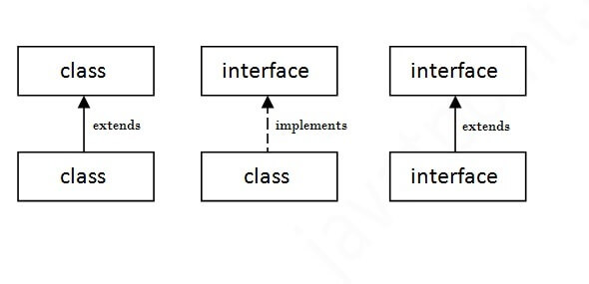
The relationship between classes and interfaces
A class extends another class, an interface extends another interface, but a class implements an interface.

Slide 17
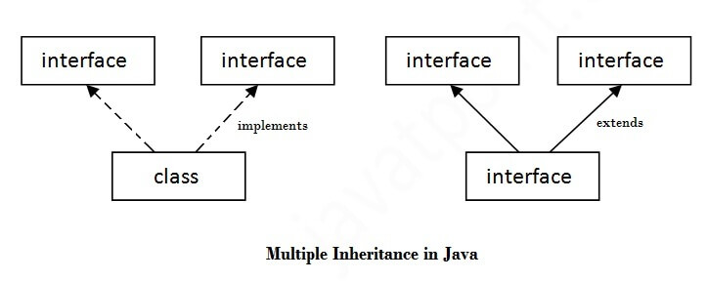
Multiple inheritance in Java by interface
If a class implements multiple interfaces, or
an interface extends multiple interfaces, it is known as multiple inheritance.

Slide 18
Multiple inheritance is not supported through class in java, but it is possible by an interface, why?
Multiple inheritance is not supported in the case of class because of ambiguity (Same method name in multiple classes).
However, it is supported in case of an interface because there is no ambiguity.
It is because its implementation is provided by the sub class.

Slide 19
interface Printable{
void print();
}
interface Showable{
void print();
}
class TestInterface1 implements Printable, Showable{
public void print()
{
System.out.println("Hello");
}
public static void main(String args[]){
TestInterface1 obj = new TestInterface1();
obj.print();
}
}
Printable and Showable interface have same methods but its implementation is provided by class TestTnterface1, so there is no ambiguity.

Slide 20
Interface inheritance
A class implements an interface, but one interface extends another interface.
interface Printable{
void print();
}
interface Showable extends Printable{
void show();
}
class TestInterface4 implements Showable{
public void print(){System.out.println("Hello");}
public void show(){System.out.println("Welcome");}
public static void main(String args[]){
TestInterface4 obj = new TestInterface4();
obj.print();
obj.show();
}
}

Slide 21
Package
Both a naming and a visibility control mechanism.
Classes can be defined inside a package that are not accessible by code outside that package
Class members can be defined that are exposed only to other members of the same package
General form of the package statement:
package pkg;
Hierarchy of packages is created by separating each package name from the one above it by use of a period. The general form of a multileveled package statement is shown here:
package pkg1[.pkg2[.pkg3]];

Slide 22
Packages
To organize classes and interfaces.
It is a group of similar types of classes, interfaces and sub-packages.
Two types of packages in Java
Built-in package (packages from the Java API)
User-defined package (create your own packages)

Slide 23
Built-in packages
The Java API is a library of prewritten classes, that are free to use, included in the Java Development Environment.
The library is divided into packages and classes.
import a single class (along with its methods and attributes), or a whole package that contain all the classes that belong to the specified package.
To use a class or a package from the library - to use the import keyword

Slide 24
Syntax
import rootpackage. name.Class;
// Import a single class
import rootpackage. name.*;
// Import the whole package

Slide 25
Import a Class
Example,
Scanner class, which is used to get user input
import java.util.Scanner;
→ java is a top level package
→ util is a sub package
→ and Scanner is a class which is present in the sub package util.

Slide 26
Import a Package
To import a whole package, end the sentence with an asterisk sign (*).
The following example will import ALL the classes in the java.util package
import java.util.*;

Slide 27
Built in pakages
Package Name | Description
java.lang | Contains language support classes ( for e.g classes which defines primitive data types, math operations, etc.) . This package is automatically imported.
java.io | Contains classes for supporting input / output operations.
java.util | Contains utility classes which implement data structures like Linked List, Hash Table, Dictionary, etc and support for Date / Time operations.
java.applet | Contains classes for creating Applets.
java.awt | Contains classes for implementing the components of graphical user interface ( like buttons, menus, etc. ).
java.net | Contains classes for supporting networking operations.
lang
awt
Javax
java
swing
net
io
util
sql etc.

Slide 28
Example:
package mypackage;
public class Simple{
public void displayMessage()
{
System.out.println("Welcome to package");
}
}
//Main.java
import mypackage.Simple;
public class Main {
public static void main(String[] args) {
Simple myObject = new Simple();
myObject.displayMessage();
}
}

Slide 29
Compilation & Run
D:\subashini new\kongu\JP\pgms>javac mypackage/Simple.java
D:\subashini new\kongu\JP\pgms>javac Main.java
D:\subashini new\kongu\JP\pgms>java Main
Welcome to package

Slide 30
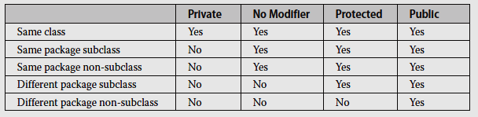
Class Member Access

Slide 31
package p1;
public class Protection {
int n = 1;
private int n_pri = 2;
protected int n_pro = 3;
public int n_pub = 4;
public Protection() {
System.out.println("base constructor");
System.out.println("n = " + n);
System.out.println("n_pri = " + n_pri);
System.out.println("n_pro = " + n_pro);
System.out.println("n_pub = " + n_pub);
} }

Slide 32
This is file Derived.java:
package p1;
class Derived extends Protection {
Derived() {
System.out.println("derived constructor");
System.out.println("n = " + n);
// class only
System.out.println("n_pri = " + n_pri);
System.out.println("n_pro = " + n_pro);
System.out.println("n_pub = " + n_pub); } }

Slide 33
This is file SamePackage.java:
package p1;
class SamePackage {
SamePackage() {
Protection p = new Protection();
System.out.println("same package constructor");
System.out.println("n = " + p.n);
// class only
System.out.println("n_pri = " + p.n_pri);
System.out.println("n_pro = " + p.n_pro);
System.out.println("n_pub = " + p.n_pub);
}
}

Slide 34
package p2;
class Protection2 extends p1.Protection {
Protection2() {
System.out.println("derived other package constructor");
// class or package only
System.out.println("n = " + n);
// class only
System.out.println("n_pri = " + n_pri);
System.out.println("n_pro = " + n_pro);
System.out.println("n_pub = " + n_pub); }
}

Slide 35
This is file OtherPackage.java:
package p2;
class OtherPackage {
OtherPackage() {
p1.Protection p = new p1.Protection();
System.out.println("other package constructor");
// class or package only
System.out.println("n = " + p.n);
// class only
System.out.println("n_pri = " + p.n_pri);
// class, subclass or package only
System.out.println("n_pro = " + p.n_pro);
System.out.println("n_pub = " + p.n_pub); } }

Slide 36
Interface Example
interface Callback
{
void callback(int param);
}
class Client implements Callback
{
public void callback(int p)
{
System.out.println("callback called with " + p);
}
}
While implementing interface method, it should be declared as public. Callback is declared public

Slide 37
The classes that implement interfaces to define additional members of their own. For example, the following version of Client implements callback( ) and adds the method nonIfaceMeth( ):
class Client implements Callback
{
// Implement Callback's interface
public void callback(int p)
{
System.out.println("callback called with " + p);
}
void nonIfaceMeth()
{
System.out.println("Classes that implement interfaces " + "may also define other members, too.");
}
}

Slide 38
interface A{
void display();
}
interface B extends A
{}
public class Test implements B{
public void display(){
System.out.print("Hi");
}
public static void main(String args[]){
Test t = new Test();
t.display();
}
}

Slide 39
Hi

Slide 40
public interface A{
protected String getName();
}
public class Test implements A{
public String getName(){
return "name";
}
public static void main (String[] args){
Test t = new Test();
System.out.println(t.getName());
}
}

Slide 41
Compilation error due to protected

Slide 42
interface calculate{
void cal(int item);
}
class display implements calculate{
int x;
public void cal(int item){
x = item * item;
}}
class interfaces{
public static void main(String [] args){
display arr = new display();
arr.x = 0;
arr.cal(2);
System.out.print(arr.x);
}}

Slide 43
Output 4

Slide 44
Nested Interface
class A {
public interface NestedIF {
boolean isNegative(int x);
}
}
class B implements A.NestedIF {
public boolean isNegative(int x) {
return x < 0 ? true: false;
}
}
class Main {
public static void main(String args[]) {
A.NestedIF nif = new B();
if(nif.isNegative(10))
System.out.println("10 is not negative");
if(nif.isNegative(-12))
System.out.println("-12 is negative");
}
}

Slide 45
import java.util.Scanner;
interface SharedConstants {
int SUN = 0; int MON = 1; int TUE = 2;
int WED = 3; int THU = 4; int FRI = 5;
int SAT = 6; }
class Days implements SharedConstants {
void answer(int x) {
switch(x) {
case SUN:
System.out.println("SUNDAY");
break;
case MON:
System.out.println("MONDAY");
break;
case TUE:
System.out.println("TUESDAY");
break;
case WED:
System.out.println("WEDNESDAY");
break;
case THU:
System.out.println("THURSDAY");
break;
case FRI:
System.out.println("FRIDAY");
break;
case SAT:
System.out.println("SATURDAY");
break; } } }
class Main{
public static void main(String args[]) {
Days q = new Days();
Scanner sc=new Scanner(System.in);
int n= sc.nextInt();
q.answer(n); } }

Slide 46
Interfaces Can Be Extended
interface A {
void meth1();
void meth2(); }
interface B extends A {
void meth3(); }
class MyClass implements B {
public void meth1() {
System.out.println("Implement meth1");
}
public void meth2() {
System.out.println("Implement meth2"); }
public void meth3() {
System.out.println("Implement meth3"); } }
class Main {
public static void main(String arg[]) {
MyClass ob = new MyClass();
ob.meth1();
ob.meth2(); ob.meth3();
} }

Slide 47
Default methods
public interface MyIF {
int getNumber();
default String getString() {
return "Default String";
} }
class MyIF1 implements MyIF
{
public int getNumber() {
return 100;
} }
class Main
{
public static void main(String args[]) {
MyIF1 obj = new MyIF1();
System.out.println(obj.getNumber());
System.out.println(obj.getString());
}
}

Slide 48
Multiple Inheritance
Java does not support the multiple inheritance of classes.
Multiple inheritance is achieved through interfaces.

Slide 49
interface PI1 {
default void show()
{
System.out.println("Default PI1");
}
}
interface PI2 {
default void show()
{
System.out.println("Default PI2");
}
}
class TestClass implements PI1, PI2 {
public void show()
{
PI1.super.show();
PI2.super.show(); }
public void showOfPI1() {
PI1.super.show(); }
public void showOfPI2() {
PI2.super.show();
}
public static void main(String args[])
{
TestClass d = new TestClass();
d.show();
System.out.println("Now Executing PI1 andPI2");
d.showOfPI1();
d.showOfPI2();
}
}

Slide 50
Which of the following statements about interfaces is not true in java?
An interface can extend another interface.
An interface can implement another interface.
A class can implement two interfaces.
A class can extend another class.
The ______ methods must be implemented when using an interface.
abstract
private
public
static

Slide 51
Which of the following is an incorrect statement about interfaces?
Interface specifies what class must do but not how it does
Interfaces are specified public if they are to be accessed by any code in the program
All variables in interface are implicitly final and static
All variables are static and methods are public if interface is defined public
Which of the following is true about methods in an interface in Java?
An interface can contain only abstract method.
We can define a method in an interface
Private and protected access modifiers can also be used to declare methods in interface
None
Which of the following is true regarding class and interface types?
You can convert from a class type to any interface type that is in the same package as the class.
You can convert from a class type to any interface type that the class implements.
You can convert from a class type to any interface type that the class defines.
You cannot convert from a class type to any interface type.

